Slide 1
Data wrangling
Processing Data in Excel Files with Python

Slide 2
Sections
Protips for happier programming
Reading in an Excel File
Understanding Excel code
Reading in Many Excel Files
ExcelFile and ExcelWriter
OpenpyXL
Reader and Writer
Excel Performance tips
Pivot stack melt
Real life application

Slide 3
Learning outcomes
After this lesson, you will be able to do the following
Read and Write Excel files using Python
Manipulate Excel File with Reader and Writer Packages
Work with Many Excel Files
Perform pivot melt and stack
Conditional append

Slide 4
Some pro-tips to prevent frustration
When you see an error related to Unicode error, it’s because of hidden characters when you copy from an application. To solve it, delete the character denoted by a red squiggly line ~
Path of the jupyter notebook is important, otherwise simple commands like reading an excel file will fail
Always run
import os
os.chdir(r'C:\Users\sshocc\Documents\PythonChatGPT\trai ning’)
os.getcwd(
The r before the location is to escape back-slash etc.)
Always save your notebook ! VS Code is not synced to the cloud
Check for typos , Python is case sensitive

Slide 5
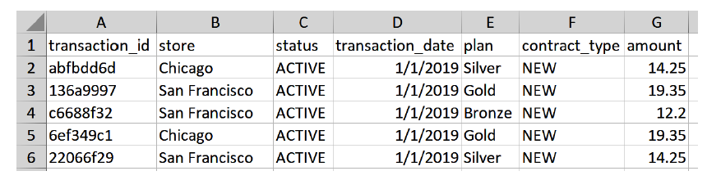
Scenario: Excel Reporting Scenario
You have a directory of many Excel files which needs to be consolidated into a report
In this example, the sales_data folder contains sales transactions for a telco provider selling different types of telco plans: bronze, silver, gold
Every month , new contracts are placed in the new folder, while existing contracts are placed in the existing folder
New customer reports are saved as xlsx files, while existing customer are saved as older xls files
Each file has 10,000 transaction, and we are tasked to show the total sales per store and month

Slide 6
Time to learn by doing Task 1 : Reading in an Excel File
Refer to the provided sales_date folder
Read the January.xlsx file in the new subfolder
Read the January.xls file in the existing subfolder
Hint:
You need to install the pandas and openpyxl and xlrd packages
Ask chatgpt on relative path and escape character

Slide 7
Task 2 : Understanding code
#Part 1
# Imports
from pathlib import Path
import pandas as pd
# Specify the absolute path to the 'sales_data' directory
# Replace this path with the actual path where your sales_data folder is located
sales_data_dir = Path("C:/Users/sshocc/Documents/PythonChatGPT/training/sales_data/existing")
# Initialize a list to store parts of the DataFrame
parts = []
# Check if the sales_data directory exists before proceeding
if sales_data_dir.exists() and sales_data_dir.is_dir():
print(f'Searching in {sales_data_dir}')
# Iterate over all Excel files within the 'sales_data' directory and its subdirectories
for path in sales_data_dir.rglob("*"):
# Determine the appropriate engine based on file extension
if path.suffix in ['.xls', '.xlsx']:
print(f'Trying to read {path}')
engine = 'xlrd' if path.suffix == '.xls' else 'openpyxl'
try:
part = pd.read_excel(path, index_col="transaction_id", engine=engine)
parts.append(part)
except Exception as e:
print(f'Failed to read {path}: {e}')
else:
print(f'Error: The directory {sales_data_dir} does not exist or is not a directory.')
#Part 2
# Proceed only if there are DataFrame parts to concatenate
if parts:
# Combine the DataFrames from each file into a single DataFrame
df = pd.concat(parts)
# Pivot each store into a column and sum up all transactions per date
pivot = pd.pivot_table(df, index="transaction_date", columns="store", values="amount", aggfunc="sum")
# Resample to end of month and assign an index name
summary = pivot.resample("M").sum()
summary.index.name = "Month"
# Specify the path for the summary report
summary_file_path = sales_data_dir.parent / "sales_report_pandas.xlsx"
summary.to_excel(summary_file_path, engine='openpyxl')
print(f"Summary report has been written to {summary_file_path}")
else:
print("No Excel files were found or read. Please check the directory path and file permissions.")

Slide 8
Task 3 : Write your own version of Task 2 code, but this time target the existing subfolder only

Slide 9
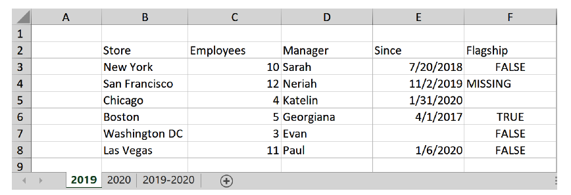
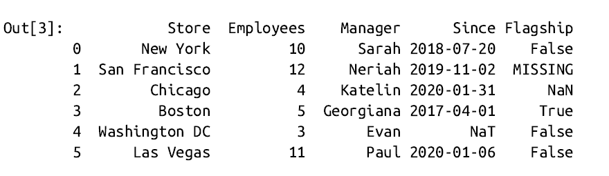
Task 4: Reading in messy Excel workbooks
Consider the excel file above. This is the first sheet of the stores.xlsx file
Try and and use the parameters sheet_name, skiprows and usecols to read this file into a pandas df
Subsequently, write a function called fix_missing to return the False if the value in the flagship column is
“Missing” or “ “ (blank)
What if we want to read in all sheet in an Excel file? And if the column headers are null, how do we treat this?

Slide 10
Exploring ExcelFile – faster reading of xls sheets
Consider the following code
import pandas as pd
with pd.ExcelFile("stores.xlsx") as f:
df1 = pd.read_excel(f, "2019", skiprows=1,usecols="B:F", nrows=2)
df2 = pd.read_excel(f, "2020", skiprows=1,usecols="B:F", nrows=2)
stores = pd.ExcelFile("stores.xlsx")
stores.sheet_names
url = ("https://raw.githubusercontent.com/fzumstein/""python-for-excel/1st-edition/xl/stores.xlsx")
pd.read_excel(url, skiprows=1, usecols="B:E", nrows=2)

Slide 11
Writing to an Excel file using to_excel method and ExcelWriter Class
Consider the following code:
import numpy as np
import datetime as dt
import pandas as pd
data=[[dt.datetime(2020,1,1, 10, 13), 2.222, 1, True],
[dt.datetime(2020,1,2), np.nan, 2, False],
[dt.datetime(2020,1,2), np.inf, 3, True]]
df = pd.DataFrame(data=data,
columns=["Dates", "Floats", "Integers",
"Booleans"])
df.index.name="index"
df.to_excel("written_with_pandas.xlsx", sheet_name="Output", startrow=1, startcol=1, index=True, header=True, na_rep="<NA>", inf_rep="<INF>")
Try : Write multiple df to the same or different sheet using pd.ExcelWriter

Slide 12
Python Packages To Manipulate Excel files
OpenPyXL
XlsxWriter
Pyxlsb
xlrd
xlwt
xlutils
Excel File Fornat | Read | Write | Edit
xlsx | OpenPyXL | OpenPyXL | OpenPyXL
xlsm | OpenPyXL | OpenPyXL | OpenPyXL
xltx, xltm | OpenPyXL | OpenPyXL | OpenPyXL
xlsb | pyxlsb | - | -
xls, xlt | xlrd | xlwt | xlutils
pandas uses the writer package installed , and is OpenPyXL and XlsxWriter is installed , XlsxWriter is the default. The engine parameter in read_excel or to_excel or ExcelFile or ExcelWriter can be used to specify which packages is used
df.to_excel("filename.xlsx", engine="openpyxl")

Slide 13
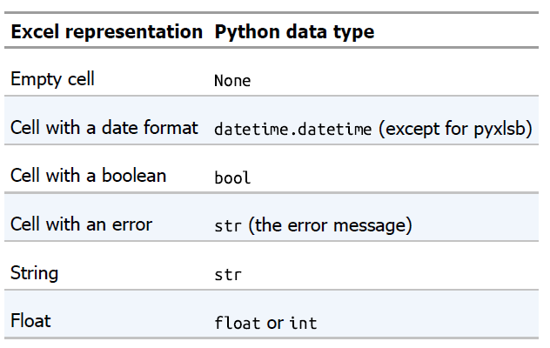
Manipulating Excel File with Reader and Writer Packages
Try: Paste excel.py into ChatGPT and try and understand how it works
How to use excel.py
import excel
values = excel.read(sheet_object, first_cell="A1", last_cell=None)
excel.write(sheet_object, values, first_cell="A1")

Slide 14
Task 5 : Reading Excel using OpenPyXL
Import pandas, openpyxl, excel and datetime
Open stores.xlsx using the load_workbook function
Declare 2019 as a sheet using the workbook loaded in the step above
List all sheetnames
Loop through sheet objects
Get the dimension of the sheets
Read the value of a single cell
Read in a range of cell values using the excel.py module

Slide 15
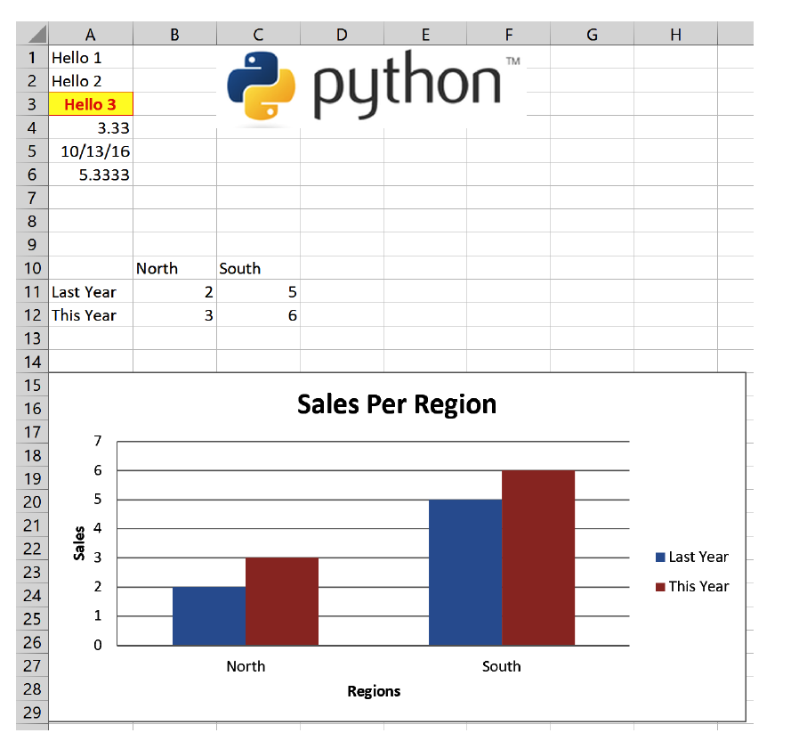
Writing with OpenPyXL
OpenPyXL can produce an excel file like this!

Slide 16
Task 6: Paste this code snippet and modify it for different effects
#Part1
import openpyxl
from openpyxl.drawing.image import Image
from openpyxl.chart import BarChart, Reference
from openpyxl.styles import Font, colors
from openpyxl.styles.borders import Border, Side
from openpyxl.styles.alignment import Alignment
from openpyxl.styles.fills import PatternFill
from openpyxl.drawing.image import Image
import datetime as dt
import excel
# Instantiate a workbook
book = openpyxl.Workbook()
# Get the first sheet and give it a name
sheet = book.active
sheet.title = "Sheet1"
# Writing individual cells using A1 notation
# and cell indices (1-based)
sheet["A1"].value = "Hello 1"
sheet.cell(row=2, column=1, value="Hello 2")
#Part2
# Formatting: fill color, alignment, border and font
font_format = Font(color="FF0000", bold=True)
thin = Side(border_style="thin", color="FF0000")
sheet["A3"].value = "Hello 3"
sheet["A3"].font = font_format
sheet["A3"].border = Border(top=thin, left=thin,
right=thin, bottom=thin)
sheet["A3"].alignment = Alignment(horizontal="center")
sheet["A3"].fill = PatternFill(fgColor="FFFF00", fill_type="solid")
# Number formatting (using Excel's formatting strings)
sheet["A4"].value = 3.3333
sheet["A4"].number_format = "0.00"
#Part3
# Date formatting (using Excel's formatting strings)
sheet["A5"].value = dt.date(2016, 10, 13)
sheet["A5"].number_format = "mm/dd/yy"
# Formula: you must use the English name of the formula
# with commas as delimiters
sheet["A6"].value = "=SUM(A4, 2)"
# Image
img = Image(r"C:\Users\sshocc\Documents\PythonChatGPT\training\images\python.png")
sheet.add_image(img, 'C1')
# Two-dimensional list (we're using our excel module)
data = [[None, "North", "South"],
["Last Year", 2, 5],
["This Year", 3, 6]]
excel.write(sheet, data, "A10")
#Part4
# Chart
chart = BarChart()
chart.type = "col"
chart.title = "Sales Per Region"
chart.x_axis.title = "Regions"
chart.y_axis.title = "Sales"
chart_data = Reference(sheet, min_row=11, min_col=1,
max_row=12, max_col=3)
chart_categories = Reference(sheet, min_row=10, min_col=2, max_row=10, max_col=3)
# from_rows interprets the data in the same way
# as if you would add a chart manually in Excel
chart.add_data(chart_data, titles_from_data=True, from_rows=True)
chart.set_categories(chart_categories)
sheet.add_chart(chart, "A15")
# Saving the workbook creates the file on disk
book.save("openpyxl.xlsx")
book = openpyxl.Workbook()
sheet = book.active
sheet["A1"].value = "This is a template"
book.template = True
book.save("template.xltx")

Slide 17
Excel-Python Performance Tips
When writing large files with OpenPyXL, install lxml to speed up the process
To keep memory under control when reading big Excel files withOpenPyXL, you should load the workbook with read_only=True, data_only=True and keep_links=False
In Python, if you want to take advantage of the multiple CPU cores that every modern computer has, you use the multiprocessing package that is part of the standard library. Make use of the provided parallel_pandas.py
import parallel_pandas
parallel_pandas.read_excel(filename, sheet_name=None)

Slide 18
Visualizing Pivot, Pivot Table, Melt, Stack/Unstack
https://github.com/nathancarter/dataframe-animations
https://nathancarter.github.io/dataframe-animations/
The stack() method works with the MultiIndex objects in DataFrame, it returns a DataFrame with an index with a new inner-most level of row labels. It changes the wide table to a long table
The unstack() is similar to stack method, It also works with multi-index objects in dataframe, producing a reshaped DataFrame with a new inner-most level of column labels.
The melt() in Pandas reshape dataframe from wide format to long format. It uses the “id_vars[‘col_names’]” to melt the dataframe by column names.

Slide 19
Setting up pivot, stack, and melt
from IPython.core.interactiveshell import InteractiveShell
InteractiveShell.ast_node_interactivity = "all"
import pandas as pd
Reference: https://towardsdatascience.com/transformations-of-stack-melt-pivot-table-901292196d9e

Slide 20
df→stack→reset_index→pivot→df
df= pd.DataFrame([[0, 1], [2, 3]],index=['cat', 'dog'],columns=['weight', 'height'])
print('{:*^80}'.format('dataframe'))
df
print('{:*^80}'.format('stacked dataframe'))
df.stack()
print('{:*^80}'.format('stacked dataframe with index in column'))
df.stack().reset_index(level = 1) #AttributeError: 'Series' object has no attribute 'pivot_table' , so must convert to dataframe before pivot_table
stacked = df.stack().reset_index(level = 1)
print('{:*^80}'.format('pivot_table recovered original dataframe (with extra name for columns)'))
recovered_df1 = df.stack().reset_index(level = 1).pivot_table(index = stacked.index, columns = 'level_1',values = 0) #pivot_table orders columns alphabetically,specifying values parameter prevents creation of useless multiindex column
recovered_df1.columns.name = None #remove 'level_1' column.name
recovered_df1

Slide 21
df→stack→df→pivot→df
print('{:*^80}'.format('dataframe'))
df
print('{:*^80}'.format('stack and convert to dataframe to expose pivot_table'))
stacked_df = pd.DataFrame(df.stack())
stacked_df
print('{:*^80}'.format('rather than unstack, pivot_table achieves the same'))
idx_lvl0, idx_lvl1 = stacked_df.index.get_level_values(0), stacked_df.index.get_level_values(1)
recovered_df2 = stacked_df.pivot_table(index=idx_lvl0,columns = idx_lvl1,values = 0)
recovered_df2

Slide 22
df→melt→add index→pivot→df
print('{:*^80}'.format('dataframe'))
df
print('{:*^80}'.format('melting loses index information'))
melted = df.melt() #melt appends columns into new "variable" column, while stack adds columns to new inner index layer (same information end up different places)
melted
print('{:*^80}'.format('manually enrich index')) # until this is solved: https://github.com/pandas-dev/pandas/issues/17440
melted.index = ['cat','dog']*2 #list(df.index)*len(df.columns) for more generalizable index generation
melted
print('{:*^80}'.format('pivot_table recovered original dataframe (with extra name for columns)'))
recovered_df3 = melted.pivot_table(index = melted.index, columns = 'variable',values = 'value')
recovered_df3.columns.name=None #remove 'variable' column.name
recovered_df3
#melting loses index while pivot_table requires index parameter

Slide 23
Task 6: Stack, unstack and melt exercise
Setting up
# import pandas module
import pandas as pd
# making dataframe
df = pd.read_csv("https://media.geeksforgeeks.org/wp-content/uploads/nba.csv")
# it was print the first 5-rows
print(df.head())

Slide 24
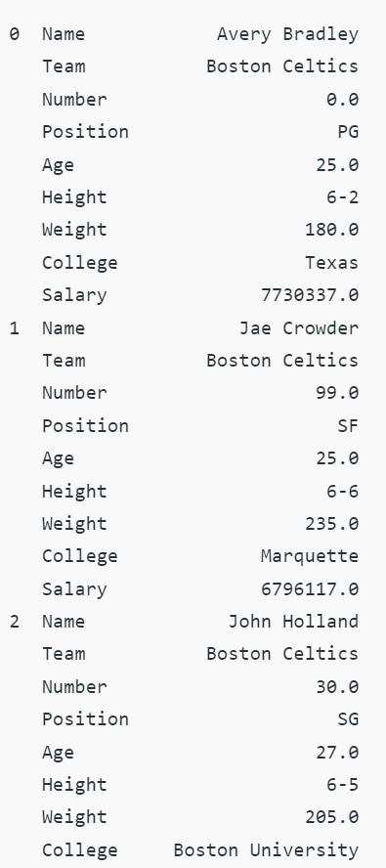
Task 6.1 : Generate this output
Decide what operation is this?

Slide 25
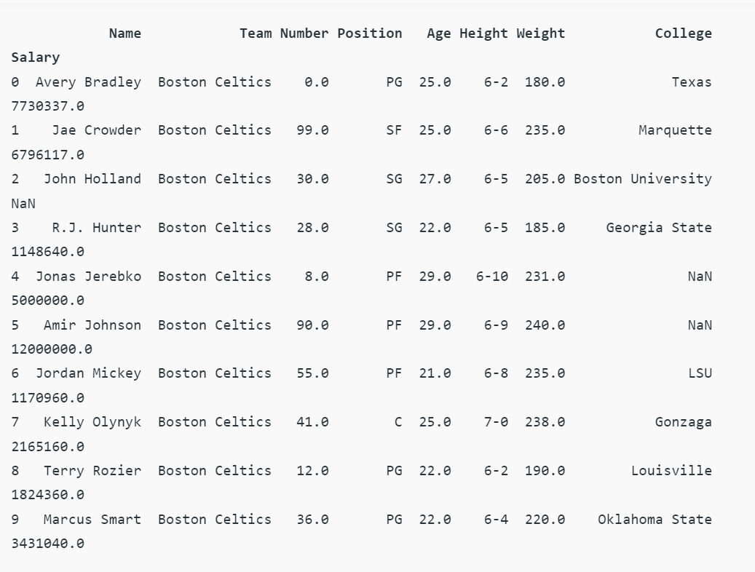
Task 6.2 : Generate this output

Slide 26
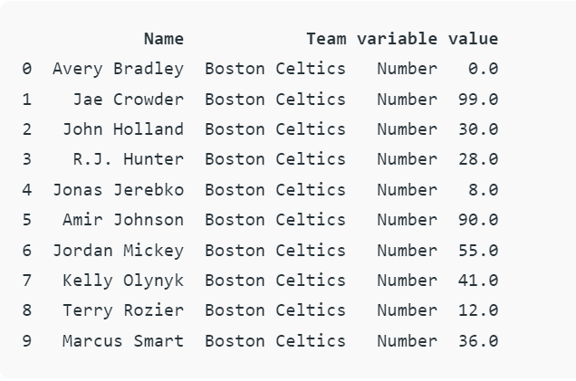
Task 6.3 : Generate this output

Slide 27
Pivot table setup
# importing pandas
import pandas as pd
# creating dataframe
df = pd.DataFrame({'Product': ['Carrots', 'Broccoli', 'Banana', 'Banana','Beans’, 'Orange', 'Broccoli', 'Banana'],
'Category': ['Vegetable', 'Vegetable', 'Fruit', 'Fruit','Vegetable', 'Fruit', 'Vegetable', 'Fruit'],
'Quantity': [8, 5, 3, 4, 5, 9, 11, 8],
'Amount': [270, 239, 617, 384, 626, 610, 62, 90]})
df

Slide 28
Task 7: Pivot
7.1 Get the Total Sales of Each Product
7.2 Get the Total Sales of Each Category
7.3 Get Total Sales by Category and Product Both
7.4 Get the Mean, Median, Minimum Sale by Category
7.5 Get the Mean, Median, Minimum Sale by Product

Slide 29
Task 8 : Final task
You are given two Excel files
File 1 : Assets, Liabilities, External, Deposits 1 EX
File 2 : Key Business Reasons EX
Biz rules : If Value Column in File 1 = Current Column in File 2 AND if File 1 Preceeding Change = File 2Mom Change THEN copy File 2 Column 3 (reason ) to append in File 1
Also copy the corresponding Source.Name that meets all the requirement !

Slide 30
THANK YOU

